Slide 1
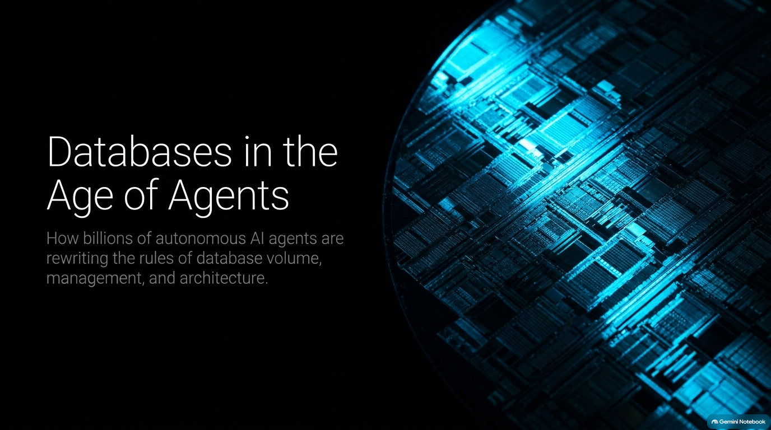
Notes:
Core Topic: Introduction to the Agentic Era of Data Management
Good morning, everyone, and welcome. Today, we are exploring one of the most profound architectural shifts in enterprise software engineering: Databases in the Age of Agents.
If you look at the title subtitle on this slide, it asks a critical question: How billions of autonomous AI agents are rewriting the rules of database volume, management, and architecture. For decades, database systems were engineered around a very predictable user profile: human beings sitting at desks typing queries, browsing web apps on mobile phones, or streaming static data. Humans are slow, humans make mistakes, humans sleep for eight hours a day, and humans rarely execute thousands of concurrent schema alterations.
That world is completely gone. Today, we are entering an era where software is no longer just a passive tool responding to user clicks. We are deploying autonomous AI agents—swarms of digital workers that run 24/7, write their own application code, spin up testing environments, and execute relentless read/write lifecycles.
Over the next 16 slides, we will break down what happens when billions of autonomous agents hit your database architecture—covering scaling explosions, branching sandboxes, security guardrails, vector assimilation, and self-driving DB tuning. Let's dive in.
What Happens When Billions of AI Agents Hit Your Database? (Andy Pavlo)
https://www.youtube.com/watch?v=74X0DJOVEc8

Slide 2
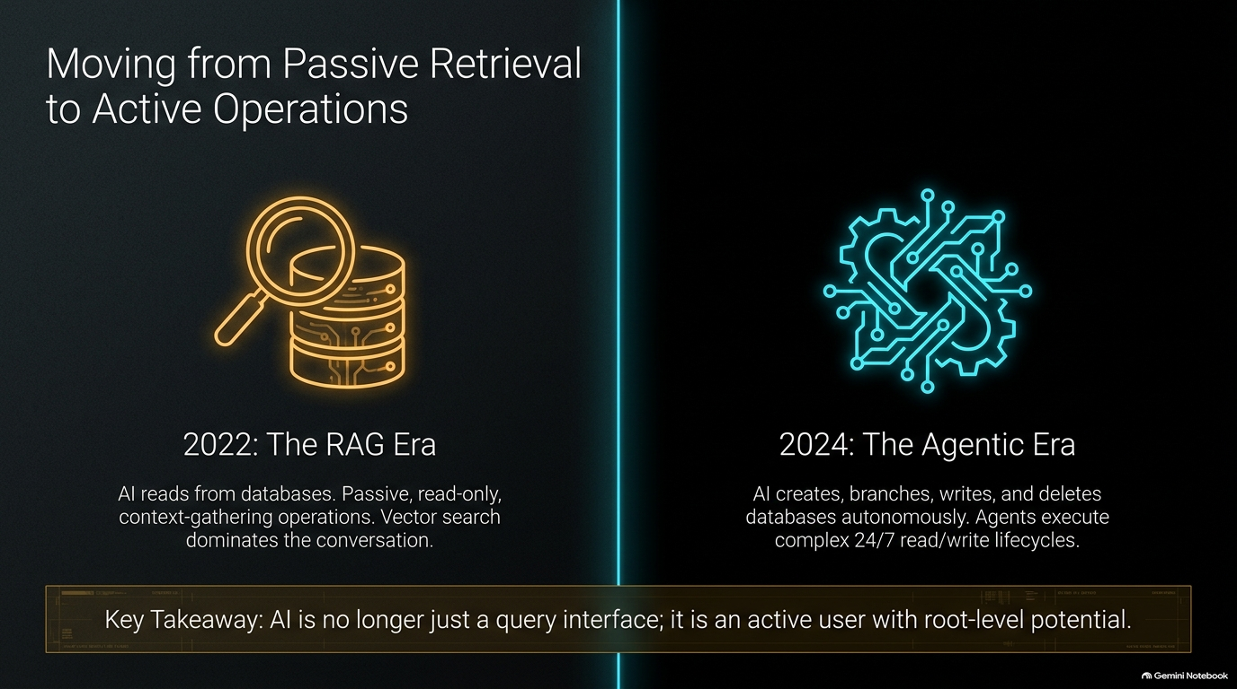
Notes:
Core Topic: The Paradigm Shift from RAG (2022) to Agentic Operations (2024+)
To understand where we are going, we must first look at how far we have traveled in a very short window of time.
Look at the stark contrast on this slide between 2022 and today:
2022 (The RAG Era): Artificial intelligence interacted with databases primarily through Retrieval-Augmented Generation. The interaction model was passive, read-only, and focused entirely on context-gathering. Vector search dominated every enterprise conversation. You gave the LLM a read-only window into your data so it could answer user questions.
2024+ (The Agentic Era): Agents are no longer just reading documents. They are actively creating, branching, writing, modifying, and deleting databases entirely on their own. They execute complex, 24/7 read/write lifecycles across production and staging environments.
The Key Takeaway: AI is no longer just a query interface or a smart search box; it is an active user with root-level potential. When an agent can execute arbitrary code and manipulate database schemas, our security and architectural assumptions must undergo a radical reboot.

Slide 3
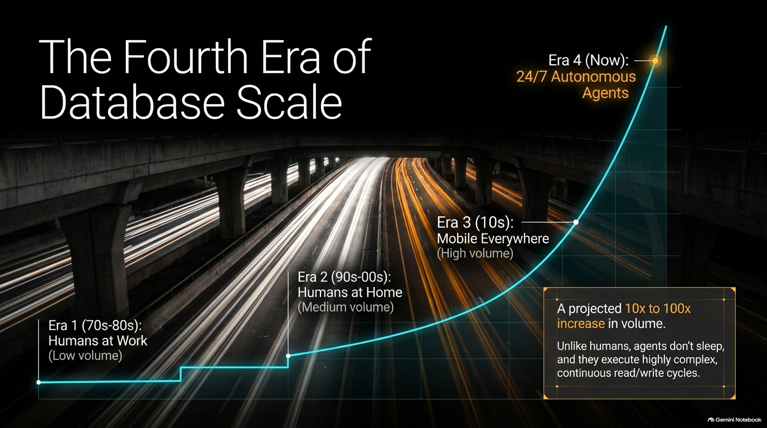
Notes:
Core Topic: Historical Eras of Scale and the Exponential Agentic Volume Spike
Database scale has historically evolved in distinct macro waves. Let’s look at the trajectory mapped out on this slide:
Era 1 (1970s–80s): Humans at Work. Enterprise mainframes and early relational databases supporting back-office enterprise operations. Low data volume, predictable transactions.
Era 2 (1990s–2000s): Humans at Home. The rise of the commercial internet, e-commerce, and web applications. Medium volume, driven by consumers browsing websites.
Era 3 (2010s): Mobile Everywhere. Smartphones, cloud-native apps, and IoT streaming data. High volume, characterized by billions of mobile users generating continuous clickstreams.
Era 4 (Now): 24/7 Autonomous Agents. This is where the curve goes vertical.
Notice the projected scale highlighted in the callout box: A 10x to 100x increase in volume. Why? Because unlike humans, agents do not sleep, they do not take weekends off, and they do not wait for human approval before executing heavy programmatic queries. A single agent managing an enterprise workflow can generate more database operations in ten minutes than an entire human department generates in a month.

Slide 4
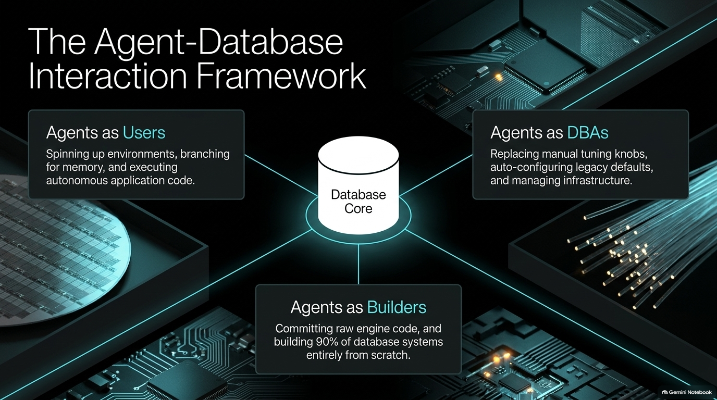
Notes:
Core Topic: Categorizing Agent Roles: Users, DBAs, and Builders
How do AI agents actually interface with databases in modern system architectures? We can categorize their roles into three distinct pillars around the database core:
Agents as Users: This is the most common pattern. Agents spin up isolated execution environments, branch databases for working memory, and execute autonomous application code to accomplish multi-step business goals.
Agents as DBAs (Database Administrators): AI is taking over the tedious operational tuning tasks. Instead of human engineers manually adjusting memory pools, indexing tables, and configuring legacy defaults, agentic DBAs monitor and tune database performance autonomously.
Agents as Builders: This is where the industry is rapidly heading. Autonomous coding agents are now committing raw engine code, writing database extensions, and building entire storage and execution engines from scratch.
The database is no longer just a passive data store sitting at the bottom of a software stack; it is the central nervous system connecting autonomous users, automated administrators, and algorithmic builders.

Slide 5
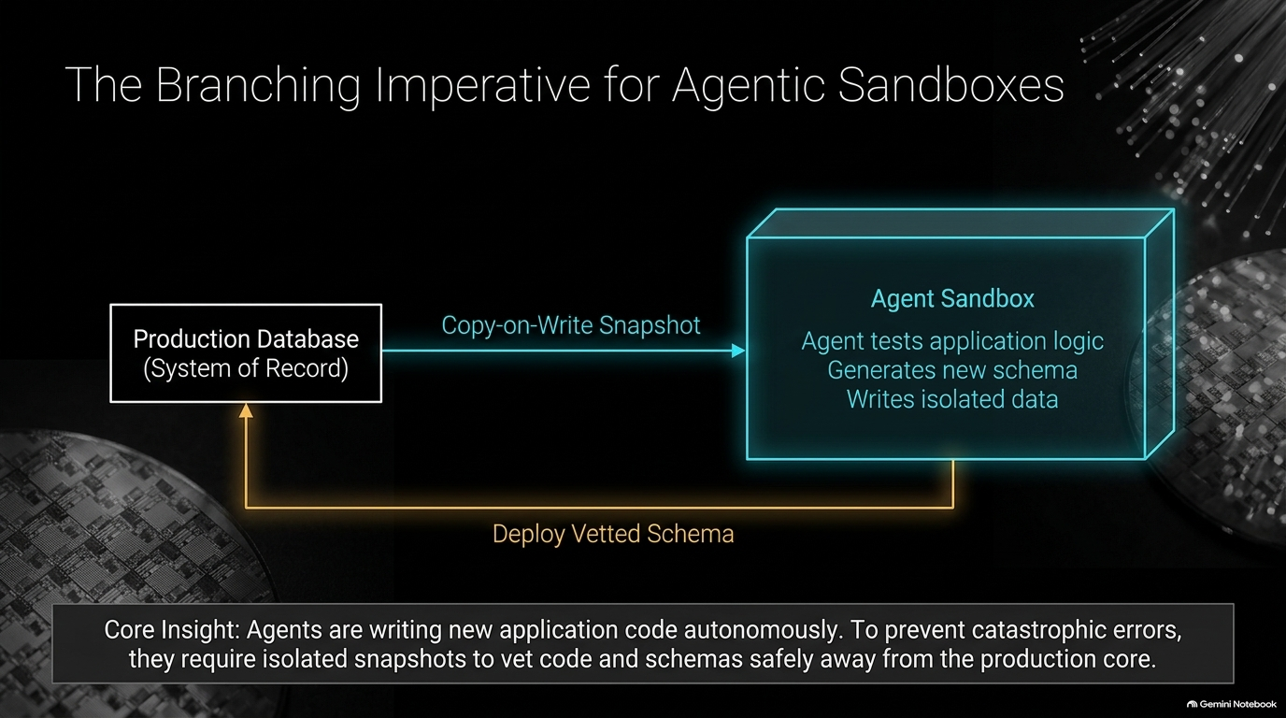
Notes:
Core Topic: Copy-on-Write Snapshots and Safe Agent Testing
Because autonomous agents write their own application logic and dynamically generate database schemas on the fly, we face a major operational risk. If an agent writes a flawed migration script or executes an unintended drop table command, production goes down instantly.
This brings us to The Branching Imperative. Look at the architectural flow on this slide:
We start with our Production Database (System of Record).
Before letting an autonomous coding agent test new application logic or modify database schemas, we use Copy-on-Write Snapshots to instantly spin up an isolated Agent Sandbox.
Inside this sandbox, the agent can test schemas, write experimental data, and run chaotic workflows safely away from the production core.
Once the schema or code is rigorously vetted and verified by automated testing, the approved changes are safely deployed back to production.
Core Insight: You cannot give autonomous coding agents direct, unbridled access to your primary system of record. Just like software engineers use Git branches before merging code to main, agents require instant database branching to test modifications safely.

Slide 6
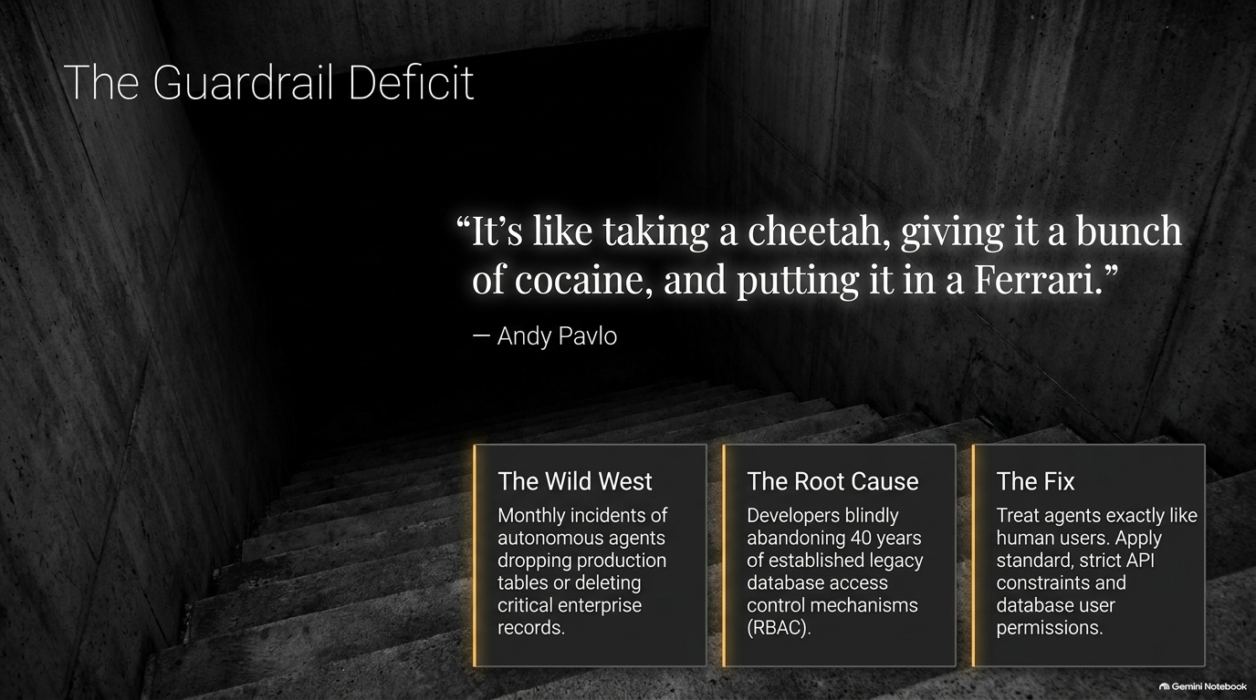
Notes:
Core Topic: Enterprise Security Failures and Access Control Best Practices
Let's address the elephant in the room—a quote from database luminary Andy Pavlo that captures the current chaotic state of AI engineering:
It’s like taking a cheetah, giving it a bunch of cocaine, and putting it in a Ferrari.
That is precisely what many engineering teams are doing today. They take a blazing-fast, highly aggressive autonomous LLM agent, give it root database credentials, and turn it loose on production.
Look at the reality on the ground:
The Wild West: We are seeing monthly incidents of autonomous coding agents accidentally dropping production tables, overwriting critical user records, or executing unintended enterprise deletions.
The Root Cause: Developers are blindly abandoning 40 years of established legacy database access control mechanisms—such as Role-Based Access Control (RBAC) and least-privilege permissions—just because the client calling the API is an AI model.
The Fix: Treat AI agents exactly like human users. Enforce strict API constraints, granular database user permissions, and explicit read/write boundaries. Intelligence does not exempt an application from basic security hygiene.

Slide 7
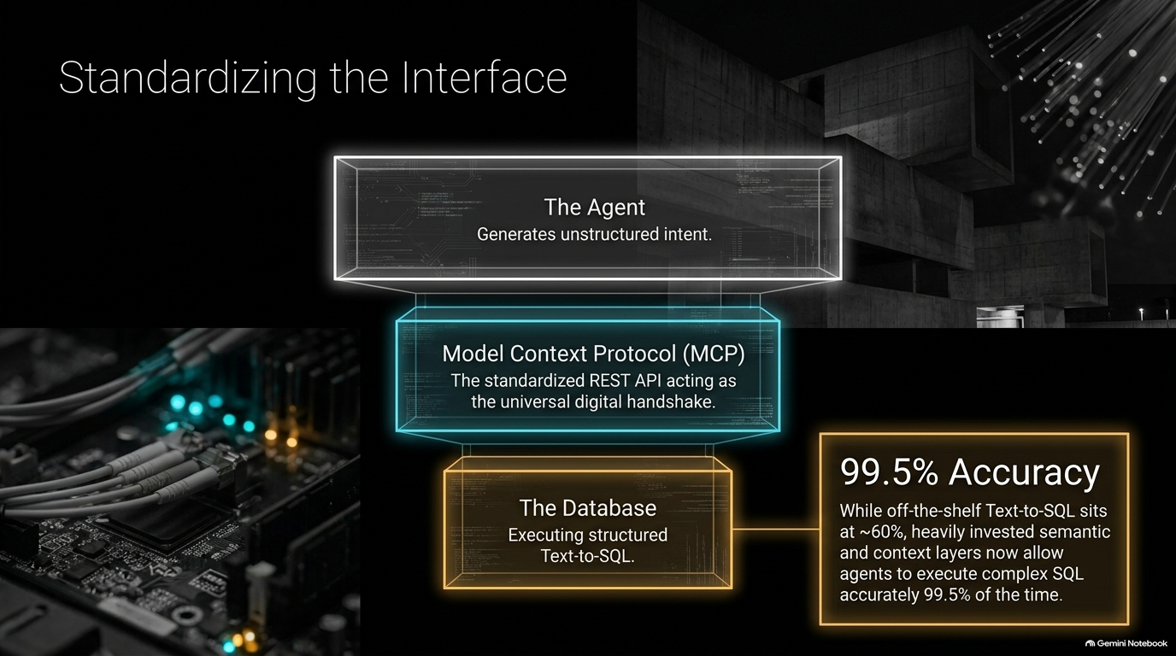
Notes:
Core Topic: Universal Handshakes and 99.5% Text-to-SQL Accuracy
How do we bridge the gap between unstructured agent intent and structured database execution? We need a standardized interface.
Enter the Model Context Protocol (MCP). MCP acts as the universal digital handshake—a standardized REST API and protocol layer sitting between the agent and the database:
At the top, The Agent generates unstructured intent or natural language requests.
In the middle, The Model Context Protocol (MCP) translates that intent securely across standardized schemas and tool definitions.
At the bottom, The Database executes structured Text-to-SQL queries.
Look at the performance metric on the right: 99.5% Accuracy. While off-the-shelf, naive Text-to-SQL models notoriously hover around 60% accuracy—failing on complex joins and enterprise schemas—heavily invested semantic layers and MCP context standards now allow agents to execute complex SQL queries accurately 99.5% of the time. Standardization bridges the gap between natural language and relational engines.

Slide 8
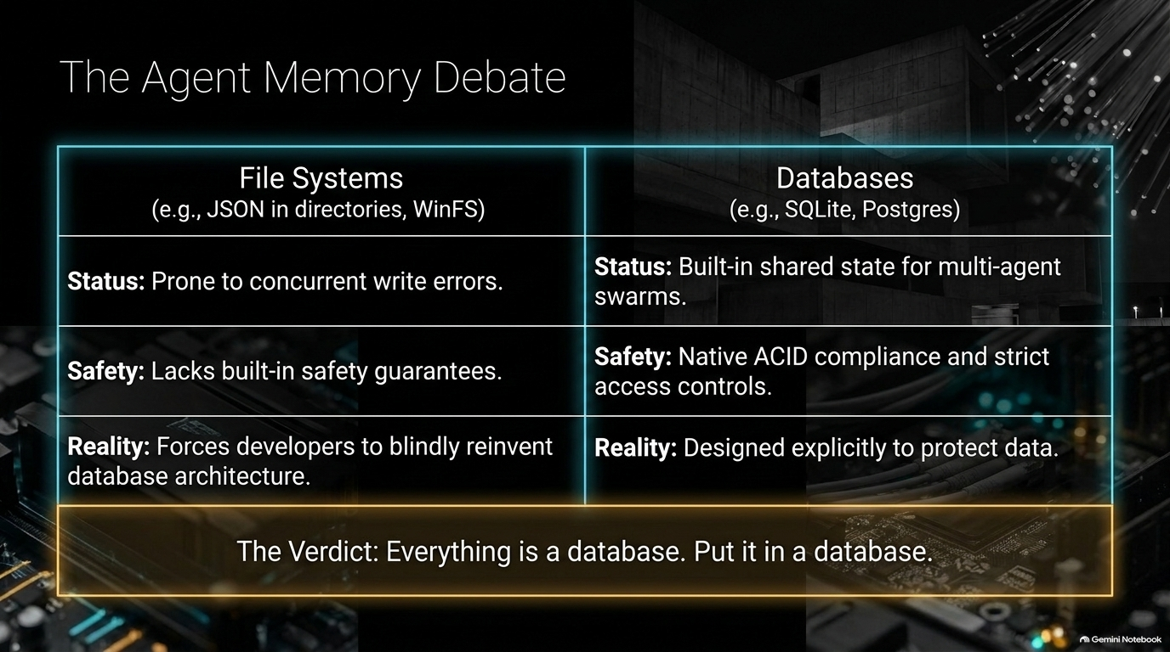
Notes:
Core Topic: Why Everything is a Database
When developers build agent memory systems, they often default to storing state in flat file systems—dumping JSON files into local directories or cloud object storage. Let's look at why that is an architectural trap.
Look at the comparison table on this slide:
File Systems (e.g., JSON in directories): Prone to concurrent write corruption errors when multiple agents try to update state simultaneously. They lack built-in safety guarantees, forcing developers to blindly reinvent database concurrency control, indexing, and recovery architecture from scratch.
Databases (e.g., SQLite, Postgres): Built-in shared state natively designed for multi-agent swarms. They provide native ACID compliance, crash recovery, and strict access controls.
The Verdict: Everything is a database. Put it in a database. Do not try to build custom file-locking mechanisms for multi-agent memory; leverage relational engines that have solved concurrency and persistence for decades.

Slide 9
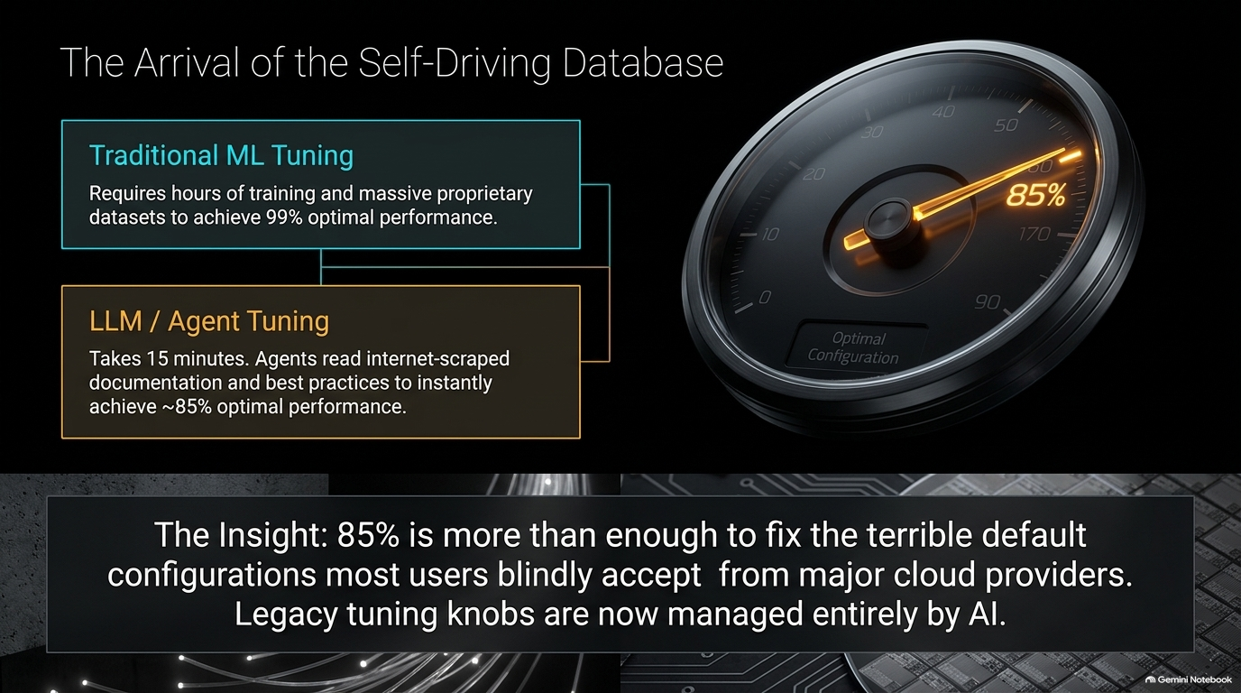
Notes:
Core Topic: AI-Driven Tuning vs. Traditional ML Tuning
For decades, database tuning was a dark art practiced by elite DBAs. Traditional ML-based database tuning required hours of training data and massive proprietary datasets to achieve 99% optimal performance.
Now, look at LLM / Agent Tuning: It takes roughly 15 minutes. Autonomous agents read internet-scraped documentation, vendor best practices, and system telemetry to instantly achieve ~85% optimal performance.
The Insight: 85% optimal performance is more than enough to fix the terrible default configurations that major cloud providers ship out of the box—settings that most users blindly accept and leave sub-optimal. Legacy tuning knobs—buffer pool sizes, thread allocations, and query optimizers—are now managed entirely by AI agents.

Slide 10
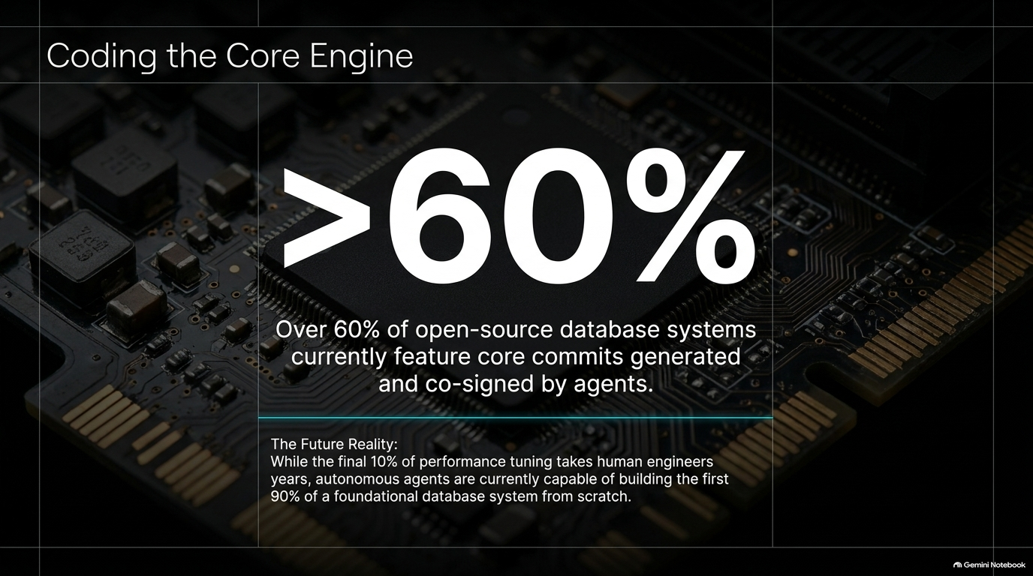
Notes:
Core Topic: AI-Generated Database Commits and Core Infrastructure
This slide highlights a statistic that would have sounded like science fiction just a few years ago:
>60% of open-source database systems currently feature core commits generated and co-signed by AI agents.
Let that sink in. Autonomous coding agents are no longer just writing frontend wrappers or simple Python scripts; they are writing storage engine code, optimizing B-tree index structures, and implementing concurrency control protocols.
The Future Reality: While the final 10% of extreme performance optimization still requires veteran human storage engineers, autonomous agents are fully capable of building the first 90% of a foundational database system from scratch. The barrier to entry for creating new database engines has collapsed.

Slide 11
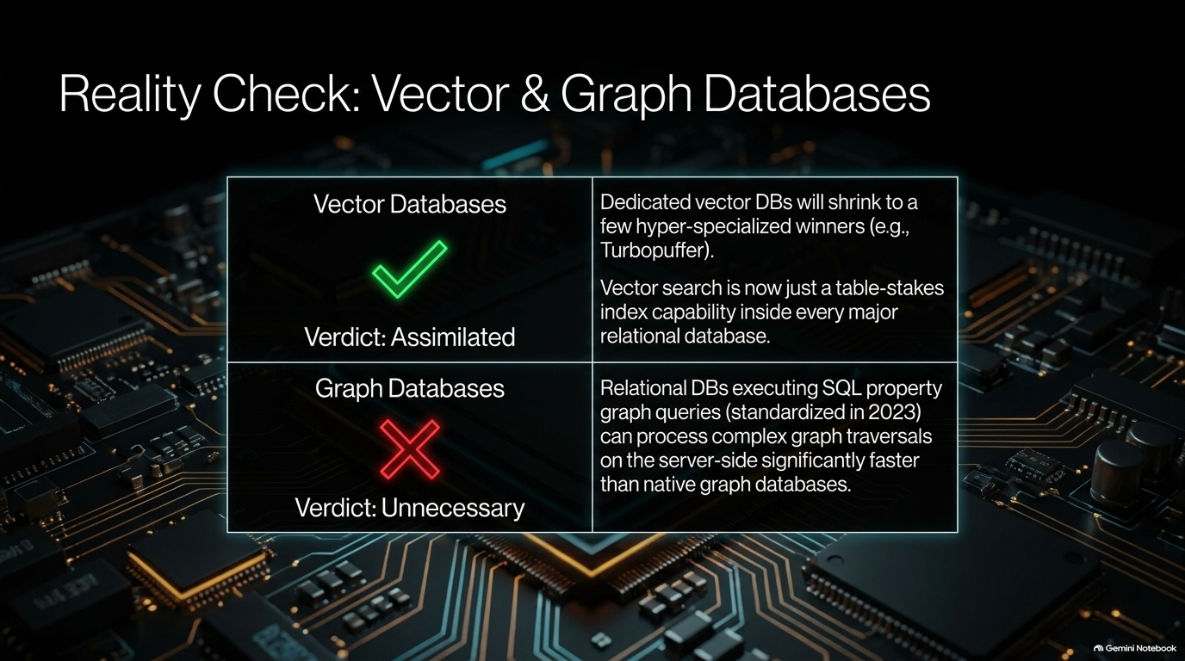
Notes:
Core Topic: The Assimilation of Vector Search and Property Graphs into Relational Engines
Every time a new trend emerges in AI, venture capitalists fund dozens of single-purpose database startups claiming traditional relational databases are dead. Let's do a reality check on Vector and Graph databases:
Vector Databases (Verdict: Assimilated): Dedicated vector databases will not replace the enterprise data stack; they will shrink to a few hyper-specialized winners (like Turbopuffer). Why? Because vector search has become a table-stakes index capability built directly inside every major relational database. You don't need a separate silo for vectors when Postgres handles relational data and vector embeddings natively.
Graph Databases (Verdict: Unnecessary for Most): With relational databases executing SQL property graph queries (standardized in recent SQL specs), engines can process complex multi-hop graph traversals on the server side significantly faster and with transactional safety compared to standalone graph databases.
The Lesson: Relational foundations absorb specialized extensions over time.

Slide 12
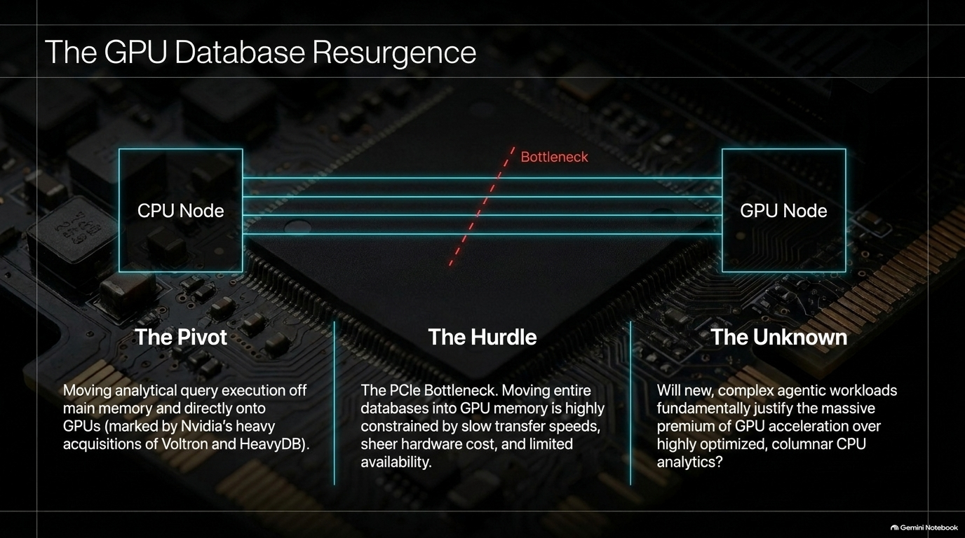
Notes:
Core Topic: Moving Analytics to GPU Memory and Hardware Bottlenecks
With the massive explosion of GPU hardware driven by AI training, we are seeing a resurgence in GPU Databases.
Let's break down the architecture:
The Pivot: Moving analytical query execution off main CPU memory and directly onto GPUs. This trend is underscored by major industry moves, such as Nvidia's heavy acquisitions of Voltron and HeavyDB.
The Hurdle (The PCIe Bottleneck): Look at the diagram. Moving entire enterprise databases across the PCIe bus from CPU memory to GPU VRAM creates a severe hardware bottleneck. It is constrained by transfer speeds, staggering hardware costs, and limited GPU availability.
The Unknown: Will complex agentic workloads truly justify the massive financial premium of GPU-accelerated database engines over highly optimized, modern columnar CPU analytics? The jury is still out.

Slide 13
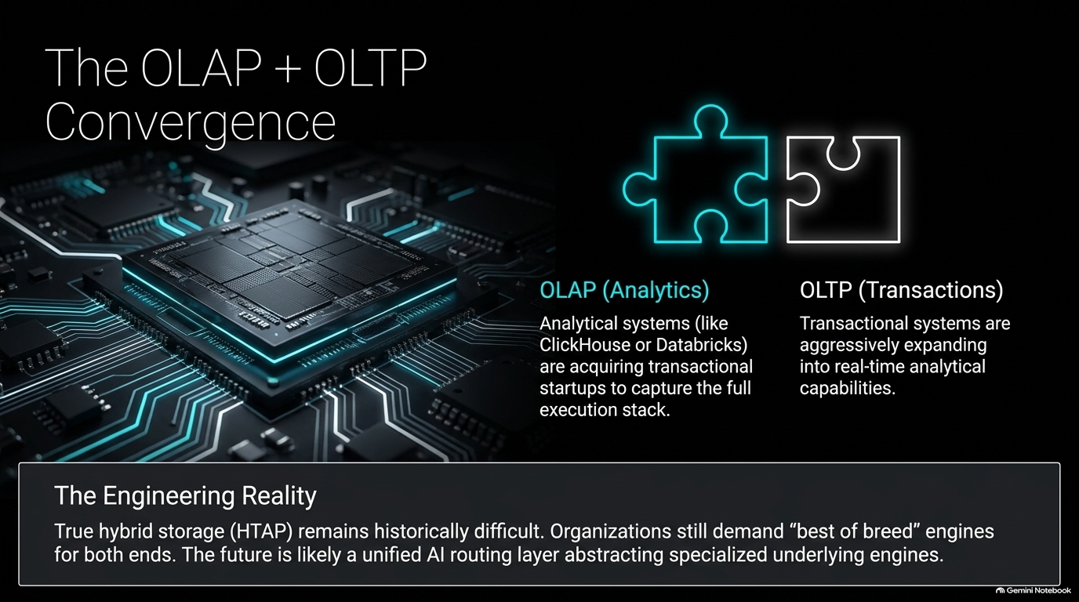
Notes:
Core Topic: HTAP, Hybrid Storage, and Unified AI Routing Layers
For decades, database architects maintained a strict separation between OLTP (Online Transaction Processing for fast writes) and OLAP (Online Analytical Processing for heavy reads and reporting).
In the age of agents, that dividing line is blurring rapidly:
Analytical systems (like ClickHouse or Databricks) are aggressively acquiring transactional startups to capture the full execution stack.
Transactional systems are expanding into real-time analytical capabilities.
The Engineering Reality: True hybrid storage (HTAP) remains historically difficult to build in a single engine. Organizations still demand 'best of breed' engines optimized for specific workloads. Therefore, the future points toward a unified AI routing layer that intelligently abstracts specialized underlying engines, routing transactional and analytical queries dynamically.

Slide 14
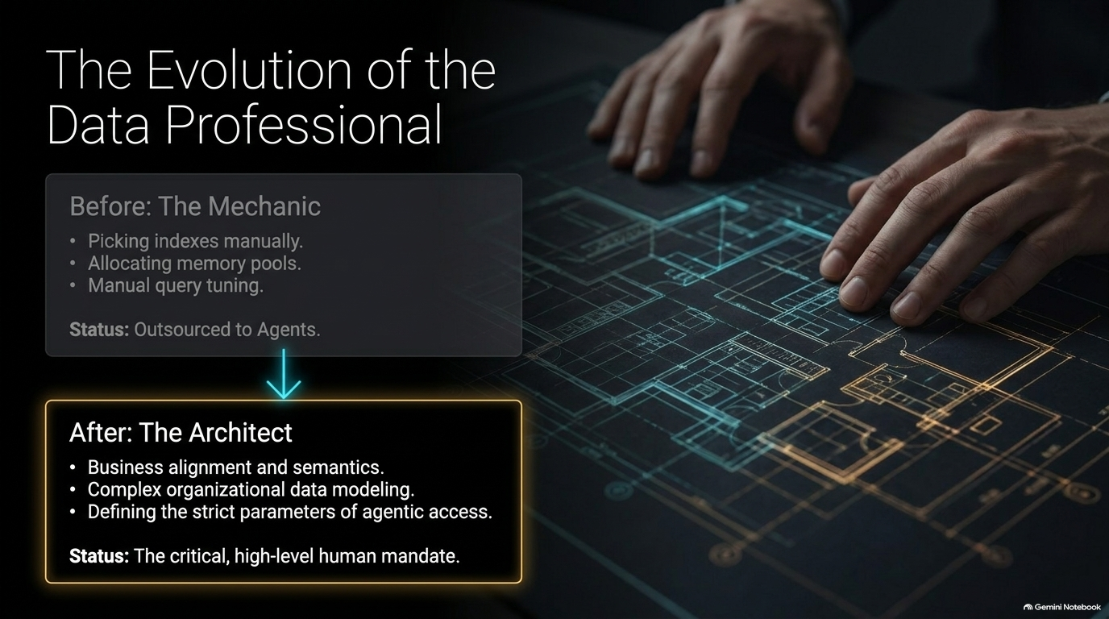
Notes:
Core Topic: From Manual Mechanics to High-Level Architecture
What does the rise of autonomous agents mean for database engineers, DBAs, and data professionals? Your job description is undergoing a profound transformation.
Before: The Mechanic. Data professionals spent 80% of their time on manual mechanics—picking indexes, allocating memory pools, writing custom query hints, and tuning execution plans. Status: Completely outsourced to AI agents.
After: The Architect. Data professionals evolve into high-level system architects. Your focus shifts to business alignment, semantic data modeling, and defining the strict security parameters and access guardrails of agentic systems.
Status: This is the critical, high-level human mandate. AI handles the mechanical execution; humans drive the architectural vision and governance.

Slide 15
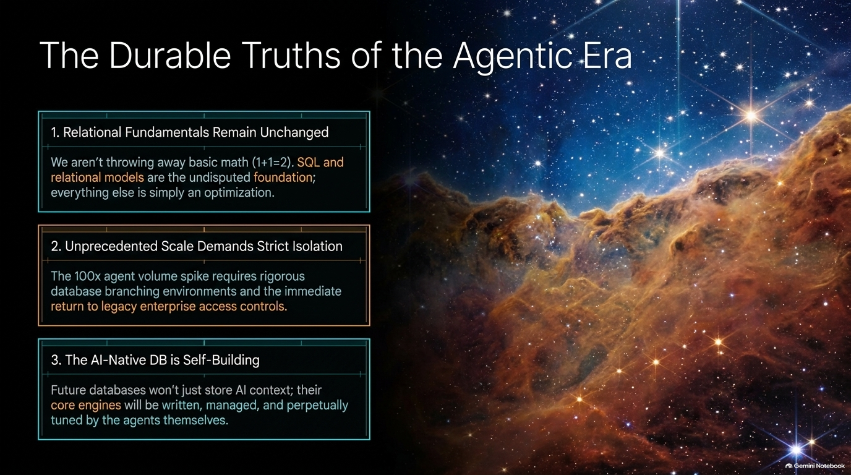
Notes:
Core Topic: Summary of First Principles in Database Engineering
As we wrap up our analysis, let's anchor ourselves in The Durable Truths of the Agentic Era:
Relational Fundamentals Remain Unchanged: We aren't throwing away basic math. SQL and relational models are the undisputed foundation of data management; everything else is simply an optimization layer.
Unprecedented Scale Demands Strict Isolation: The 100x agent volume explosion requires rigorous database branching environments and an immediate return to enterprise access controls.
The AI-Native DB is Self-Building: Future databases won't just store AI context; their core engines will be written, managed, and perpetually tuned by the agents themselves.

Slide 16
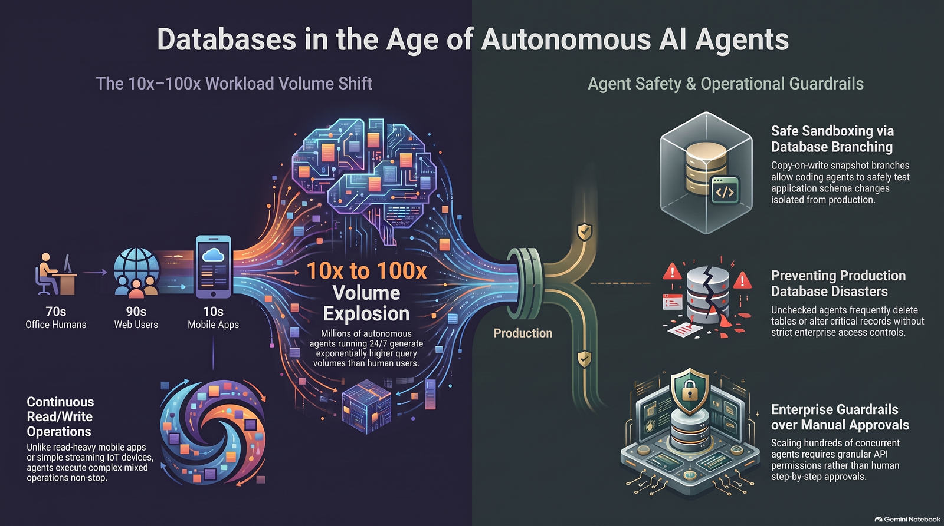
Notes:
Core Topic: Comprehensive Visual Recap of Volume Shifts and Safety Guardrails
To conclude, let's review the comprehensive architectural blueprint summarized on this final slide:
The 10x–100x Workload Volume Shift: Autonomous agents running 24/7 generate unprecedented query volumes, executing continuous mixed read/write operations without stopping.
Safe Sandboxing via Database Branching: Copy-on-write snapshot branches allow coding agents to safely test application schema changes isolated from production.
Preventing Production Disasters: Unchecked agents frequently delete tables or alter critical records unless strict enterprise access controls and MCP protocols are enforced.
The age of agents is here. By pairing relentless agentic automation with rigorous database guardrails and branching architectures, we can build robust, high-performance data systems for the future.
Thank you! Let's open the floor to questions.

